Slide 1
timedatectl: set-time
Alex Richardson & Joshua Patterson

Slide 2
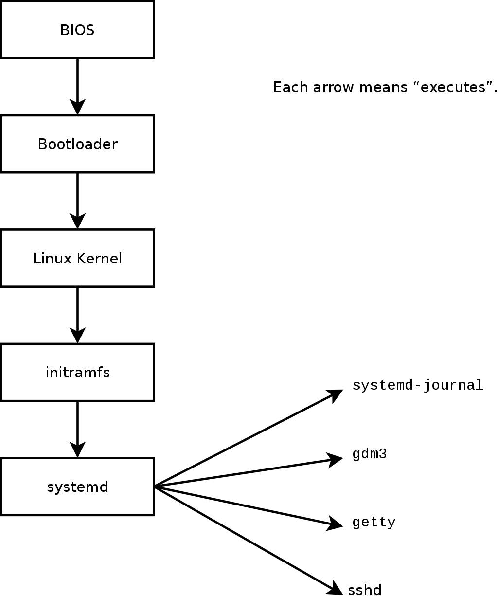
timedatectl
The timedatectl command in Linux allows you to query and change the system clock and its settings. It comes as part of systemd
$ timedatectl
Local time: Thu 2018-09-21 16:08:56 CEST
Universal time: Thu 2018-09-21 14:08:56 UTC
RTC time: Thu 2018-09-21 14:08:56
Time zone: Europe/Warsaw (CEST, +0200)

Slide 3
Our Planned Modification:
$ timedatectl --12hr
>> 2 MAY 2019 4:20 pm
$ timedatectl settime “2 MAY 2100 1:00 pm”
>> 2 MAY 2100 1:00 pm
We wanted to add a way to view the time in 12hr format
We wanted to add a way to change the system time in 12hr format

Slide 4
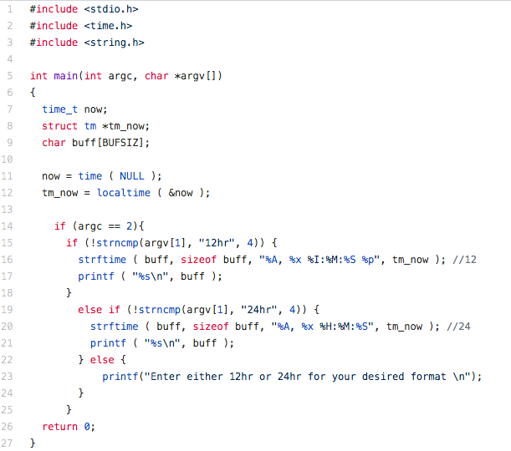
Creating the Module
conversion specifications
%A = Day of the week %S = Seconds
%x = Month, Day, Year %p = AM/PM indicator
%I = 12 Hour “Hour”
%M= Minutes
Issues:
-A kernel module is not an application so there is no main() function.
-There is no printf function, just printk
-formatting issues
The strftime() function formats the broken-down time tm according to
the format specification format

Slide 5
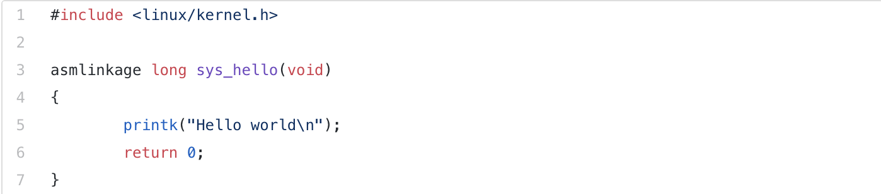
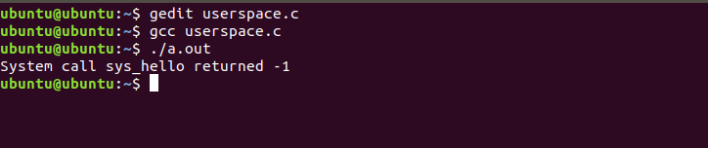
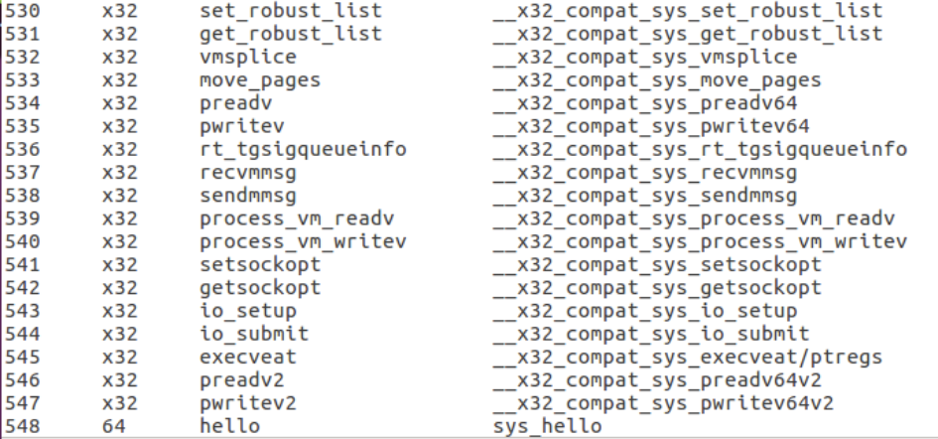
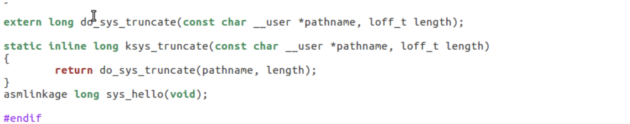
Creating a Hello World Module
Potential Issues from accessing a system call from userspace:
Passing control to the particular point in kernel with switching processor from user mode to kernel mode and returning it back with switching processor back to the user mode.
Specifying of id of the requested kernel service.
Passing of parameters for the requested service.
Capturing the result of the service.
Added to system call table
Added to system call table
Added to system call header

Slide 6


